Slide 1

8085 Microprocessor
Dr. Manju Khurana
Assistant Professor, CSED
TIET, Patiala
manju.khurana@thapar.edu

Slide 2
Interrupts
Introduction to Microprocessor Based Systems Design
Interrupt is a mechanism by which an I/O or an instruction can suspend the normal execution of processor and get itself serviced. Generally, a particular task is assigned to that interrupt signal. In the microprocessor based system the interrupts are used for data transfer between the peripheral devices and the microprocessor.
After receiving an interrupt signal from the peripheral, the microprocessor executes current instruction completely.
Store the contents of program counter i.e. return address on the stack and then executes interrupts service (ISR) to provide service to the interrupting device.
After servicing the device, the microprocessor transfer program control back to the program where interrupt occurs by reloading the content of program counter which has been stored on the stack when an interrupt occurs.
2

Slide 3
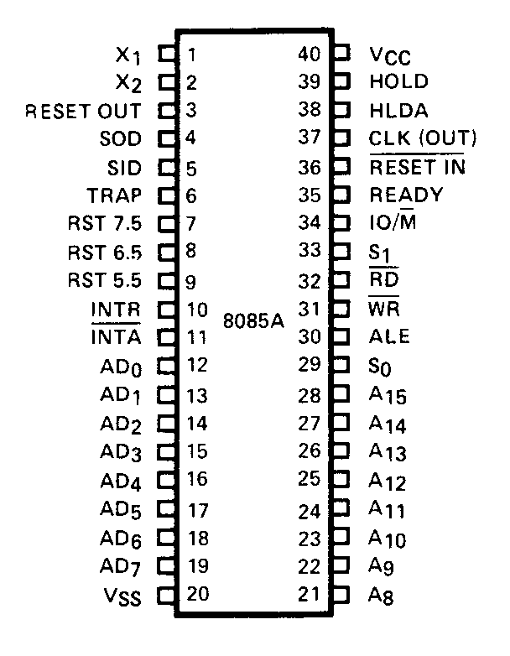
Interrupt pins on IC
Introduction to Microprocessor Based Systems Design
There are 5 interrupt inputs:
TRAP (non-maskable)
RST7.5
RST6.5
RST5.5
INTR
3

Slide 4
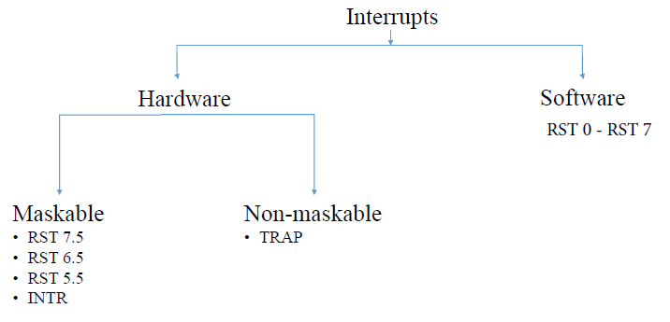
Classification of Interrupts
Introduction to Microprocessor Based Systems Design
Masking is done by software.
Non maskable-
-it cannot be enable,cannot be disable,
It is not accessible to the user, used in emergency
Situation such as power shut off.
Maskable Interupt can be on and off as per user
requirement
4

Slide 5
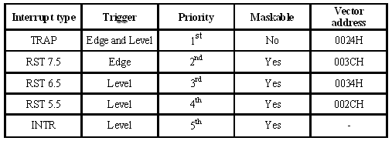
Hardware Interrupts
Introduction to Microprocessor Based Systems Design
(8*n)/16
5

Slide 6
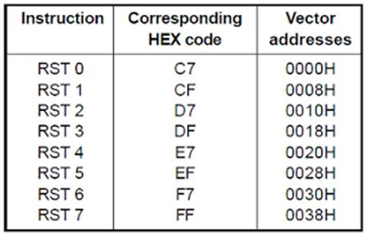
Software Interrupts
Introduction to Microprocessor Based Systems Design
6

Slide 7
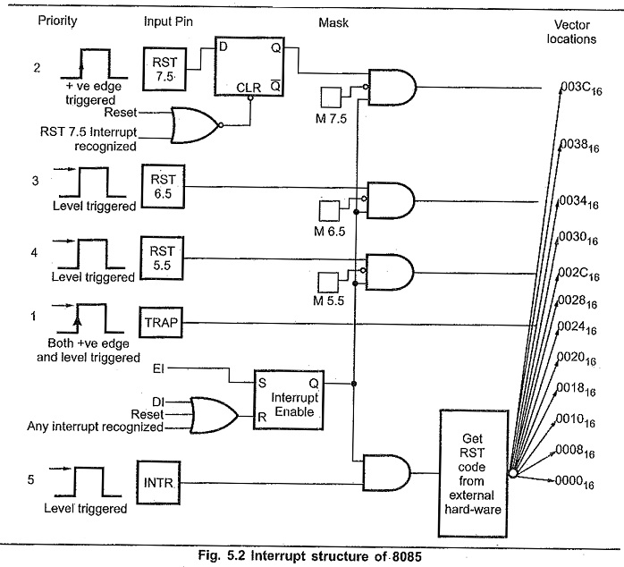
Schematic Diagram of 8085 Interrupts
Introduction to Microprocessor Based Systems Design
7

Slide 8
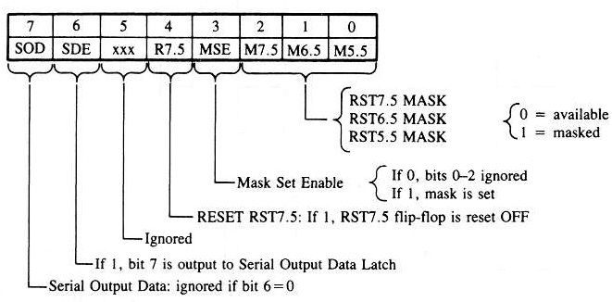
SIM (Set Interrupt Mask) Instruction
Introduction to Microprocessor Based Systems Design
This is a multipurpose instruction and used to implement The 8085 interrupts 7.5, 6.5, 5.5, and serial data output. The instruction interrupts the accumulator contents as following:
8

Slide 9
1. Example: Enable all the interrupts of Intel 8085. First, determine the contents of the accumulator
Introduction to Microprocessor Based Systems Design
- Enable 5.5 bit 0 = 0
- Enable 6.5 bit 1 = 0
- Enable 7.5 bit 2 = 0
- Allow setting the masks bit 3 = 1
- Don’t reset the flip flop bit 4 = 0
- Bit 5 is not used bit 5 = 0
- Don’t use serial data bit 6 = 0
- Serial data is ignored bit 7 = 0
EI ; Enable interrupts including INTR
MVI A, 08 ; Prepare the mask to enable RST 5.5, 6.5 and 7.5.
SIM ; Apply the settings RST masks
0 | 0 | 0 | 0 | 1 | 0 | 0 | 0
Contents of accumulator are: 08 H
9

Slide 10
2. Example: Set the interrupt masks so that RST6.5 is enabled and disable RST7.5 and RST5.5. First, determine the contents of the accumulator
Introduction to Microprocessor Based Systems Design
- Disable 5.5 bit 0 = 1
- Enable 6.5 bit 1 = 0
- Disable 7.5 bit 2 = 1
- Allow setting the masks bit 3 = 1
- reset the flip flop bit 4 = 1
- Bit 5 is not used bit 5 = 0
- Don’t use serial data bit 6 = 0
- Serial data is ignored bit 7 = 0
EI ; Enable interrupts including INTR
MVI A, 1D ; Prepare the mask to enable RST 6.5, disable 6.5 and 5.5.
SIM ; Apply the settings RST masks
0 | 0 | 0 | 1 | 1 | 1 | 0 | 1
Contents of accumulator are: 1D H
10

Slide 11
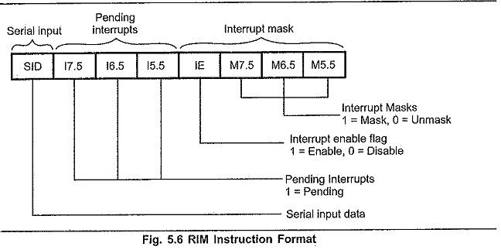
RIM (Read Interrupt Mask) Instruction
Introduction to Microprocessor Based Systems Design
The Read Interrupt Mask, RIM, instruction loads the status of the interrupt mask, the pending interrupts and the contents of the serial input data line, SID, into the accumulator. Thus, it is possible to monitor status of interrupt mask, pending interrupts and serial input. There are number of Types of Interrupts in 8085. When one interrupt is being serviced, other interrupt requests may occur. If the interrupt requests are of higher priority, 8085 branches program control to the requested interrupt service routines. But when the interrupt requests are of lower priority, 8085 stores the information about these interrupt requests. Such interrupts are called pending interrupts. The status of pending interrupts can be monitored using RIM instruction.
11

Slide 12


